Slide 1

Metabolite vs Sofa Score Temporal Analysis
Kamala Natarajan

Slide 2

Research Hypothesis
Post-operative patients exhibiting high sofa scores showcase increasing metabolite values over time after ICU admission and are also more likely to develop ARDS.

Slide 3
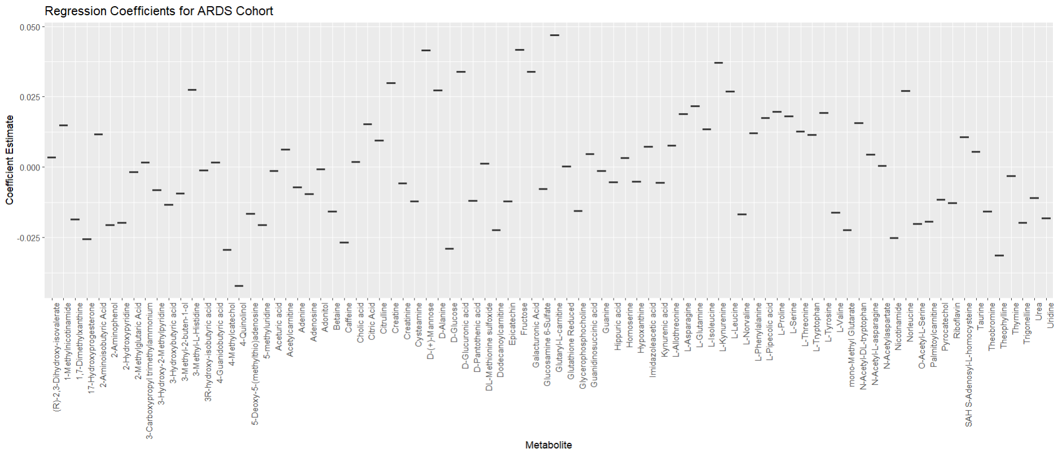

Slide 4
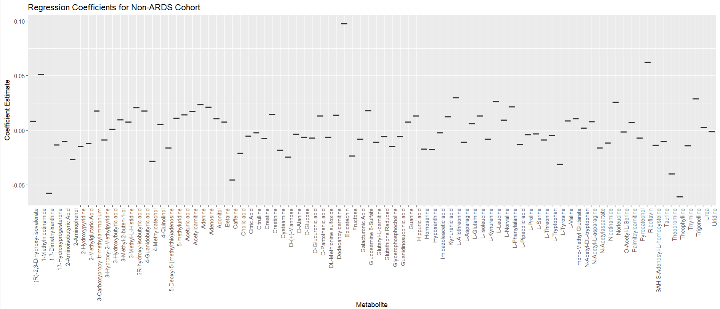

Slide 5
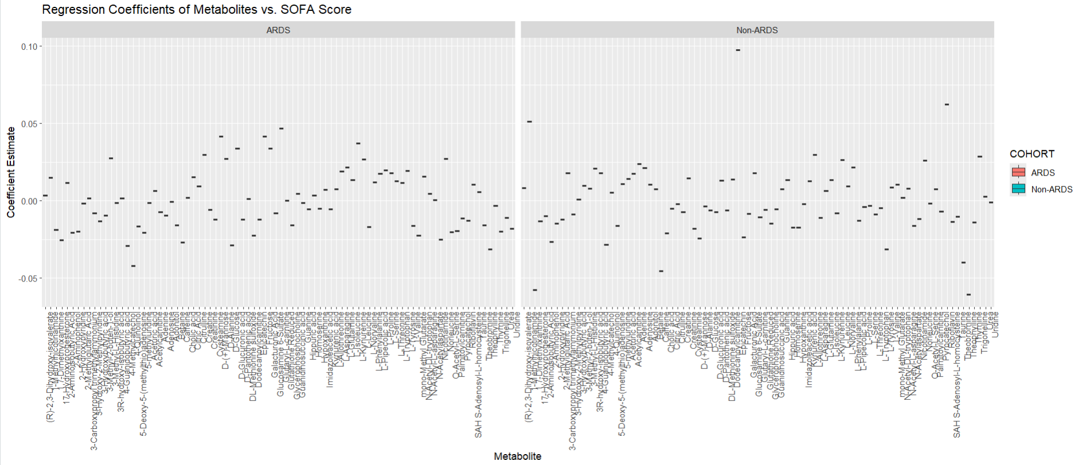

Slide 6
Determining Correlations Using Correlation of Coefficient Values
None of the metabolites displayed even a weak positive/negative correlation to SOFA scores for either of the cohorts.
Epicatechin was the only metabolite in the non-ARDS cohort that showed almost a 0.1 positive correlation to SOFA score.
Results were saved as a csv file and all metabolites showed no correlation to SOFA score based purely on regression analysis.

Slide 7
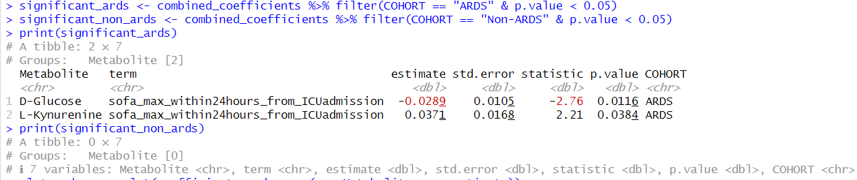
Determining Significance using p-value
This result was not considered given the low sample size of 40 individuals. The correlation of the co-efficient value is too small to consider a positive correlation for L-Kynurenine or a negative correlation for D-Glucose in this case.

Slide 8
Conclusion
Key Findings:
Hypothesis not supported.
No specific trends were observed in the metabolite values over time, indicating a lack of consistent increase or decrease across the defined periods.
Metabolite fluctuations appeared random without a clear pattern correlating to the duration post-surgery or SOFA score severity.
Possible Explanations for the Results:
The random fluctuations in metabolite levels might reflect individual physiological responses to surgery, which can vary significantly due to factors like pre-existing conditions, age, and surgical intervention specifics.
A sample of 40 patients may not provide sufficient power to detect subtle trends or differences in metabolite changes over time.
Post-operative metabolic responses can be influenced by numerous factors, including medications, treatments like fluid therapy or mechanical ventilation, and complications such as infections or other organ dysfunctions.
The absence of detectable trends in metabolite levels suggests that monitoring these may not provide reliable indicators for the development of ARDS in post-operative patients solely based on the time intervals and SOFA scores used in this study.
Further research with a larger cohort and more frequent sampling might be necessary to clarify the role of metabolites in predicting ARDS risk post-surgery.
Recommendations for Future Research:
Increasing the sample size to enhance the statistical power of the study.
Implementing more frequent or strategically timed sampling of metabolites to capture relevant changes more effectively.
Exploring additional variables such as specific types of surgery, patient demographics, and detailed clinical interventions that might influence metabolite dynamics.

